Slide 1

work experience
MONDAY 13 – Friday 17 July 2026

Slide 2
Mrs Wiseman
work experience coordinator

Slide 3
Welcome to Work experience
......you need to start planning today!
Work Experience is the last week of the summer term –
Monday 13th to Friday 17th July 2026
Everyone has to find their own placement

Slide 4
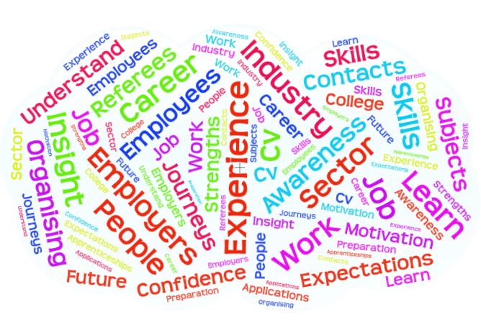
Benefits of work experience:
Try out a job
Develop employability skills
Gain experience for your CV and applications
Link curriculum learning to work
Improve motivation to do well
Build confidence
Make memories

Slide 5

How to find a placement:
Write a shortlist of placement ideas
Talk to family and friends - do they know anyone?
Look around you – local businesses – where can you get to?
Newspapers and magazines - Just Aylsham and EDP
Social Media
Research online….
Apprenticeship and job vacancies

Slide 6
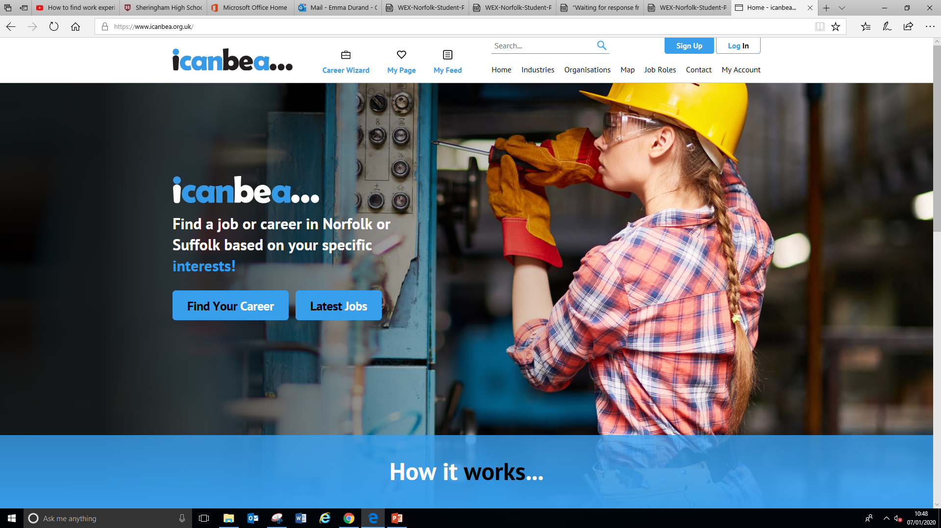
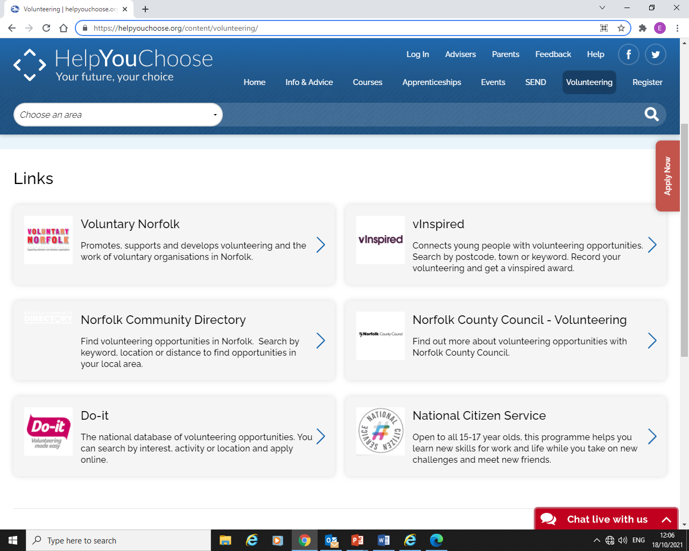
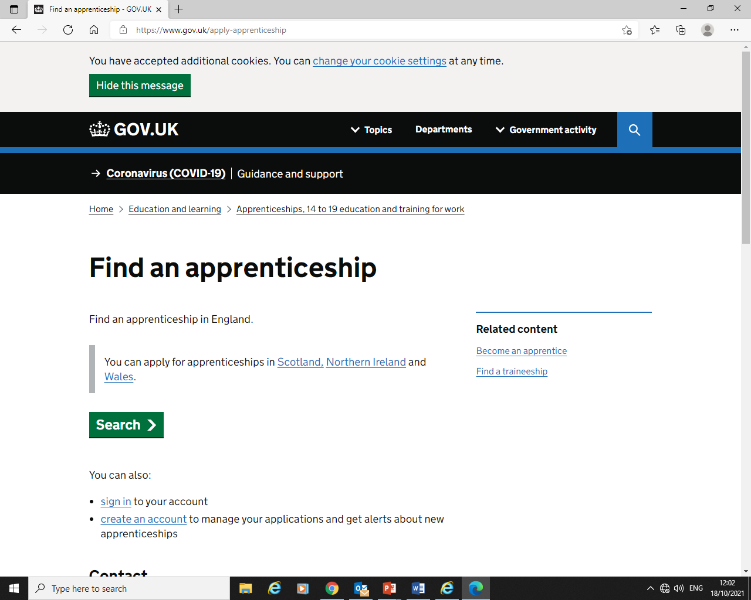
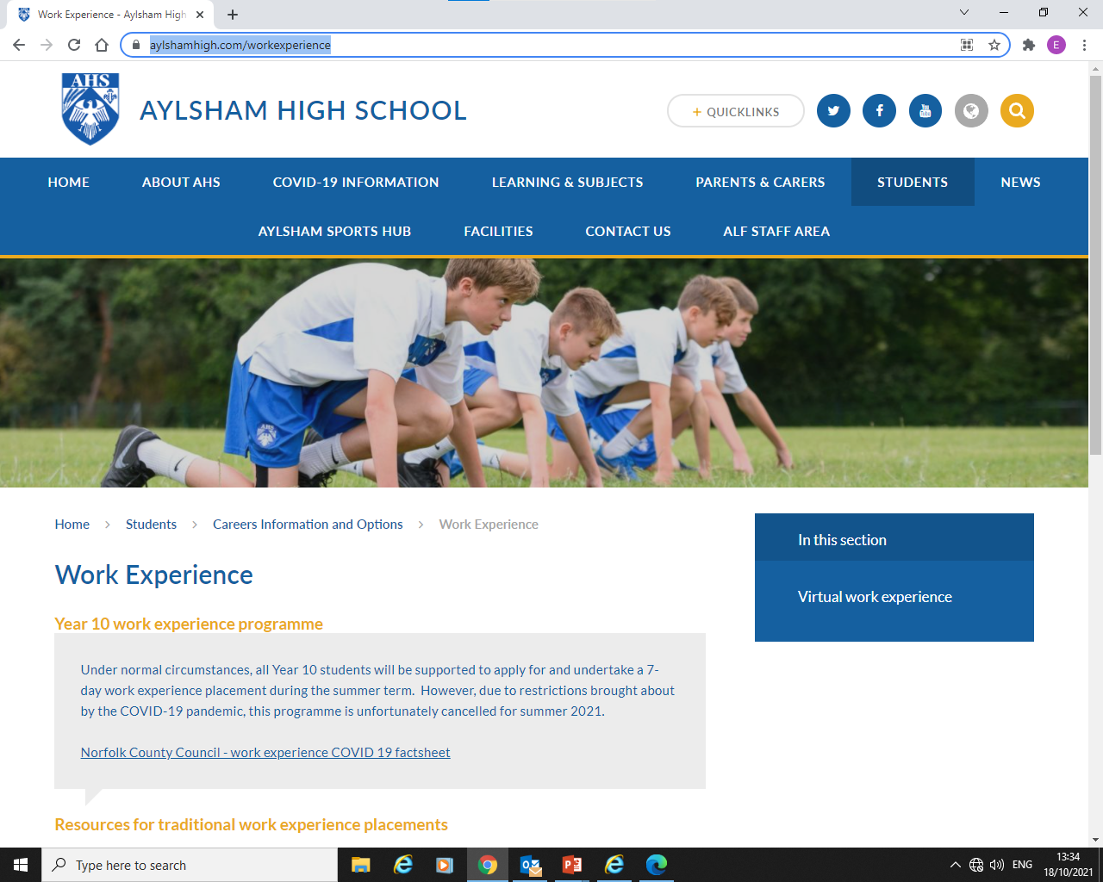
Good websites for research:
QR codes in booklet

Slide 7
How to approach an employer
Try and get a named contact
Write or email to introduce yourself and ask if they can offer you a placement
Enclose your CV
Follow up by phone or email
Call in, if possible
Templates in the booklet

Slide 8
Deadline to organise your placement
Placements must be organised by
February half term
Friday February 13th 2026
Everyone has to find their own placement

Slide 9
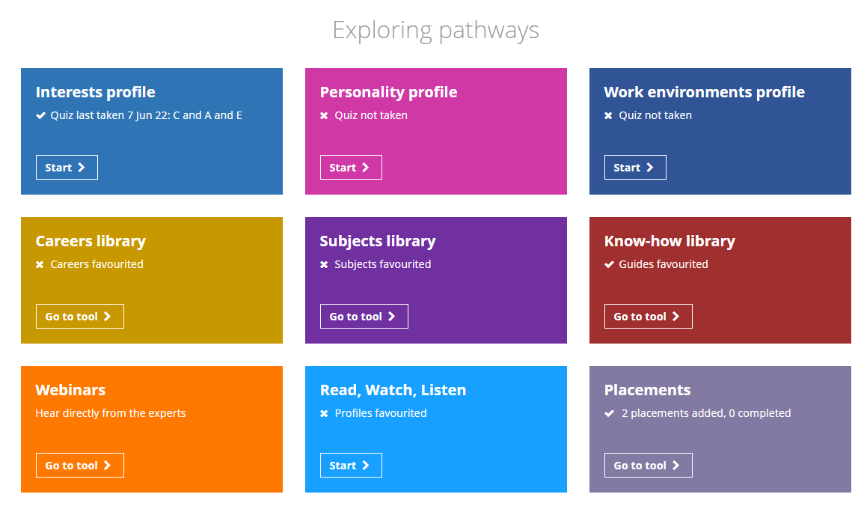

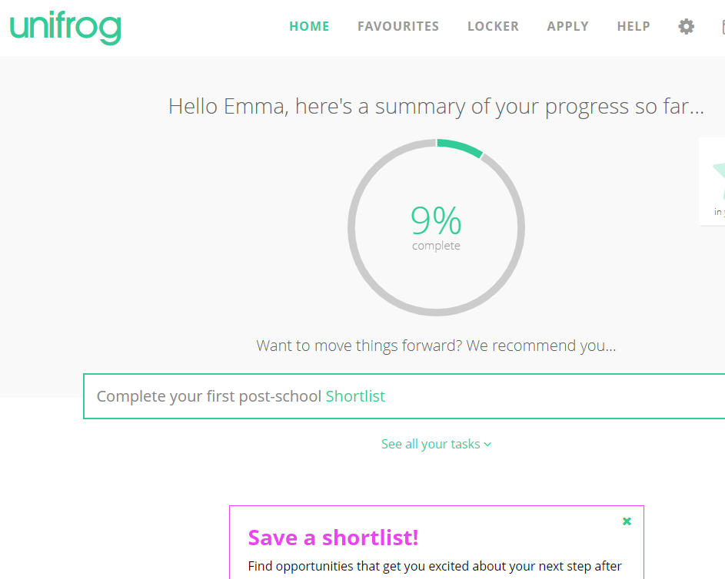
Unifrog Placement tool

Slide 10
unifrog
It’s AMAZING!
A one-stop-shop to explore your options for your future - quizzes, job profiles, apprenticeship vacancies, college information etc. .
Careers platform to administer work experience
Automatically creates a series of forms
Check your email to re-set log-on details

Slide 11
What you need to do now
Read the booklet you will be given today
Discuss it with your parents/carers
Explore Unifrog!

Slide 12

What if you are stuck?
  Talk to:
  Family/friends
  Your Tutor
  Other students
  Speak with Mrs Wiseman room 38 Tuesday & Thursdays

Slide 13

In the summer term
More information and guidance to make sure you are:
Prepared, ready and excited
Safe
Able to make the most of the opportunity
…whilst on placement

Slide 14
Good Luck!!
Work experience
14 - 18 July 2025

