Slide 1

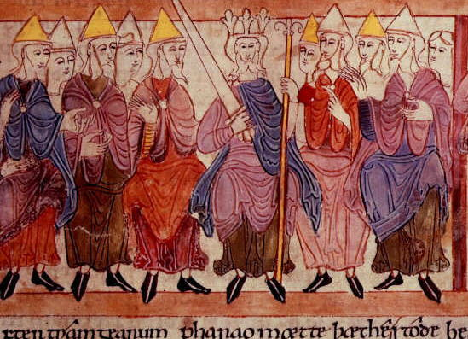
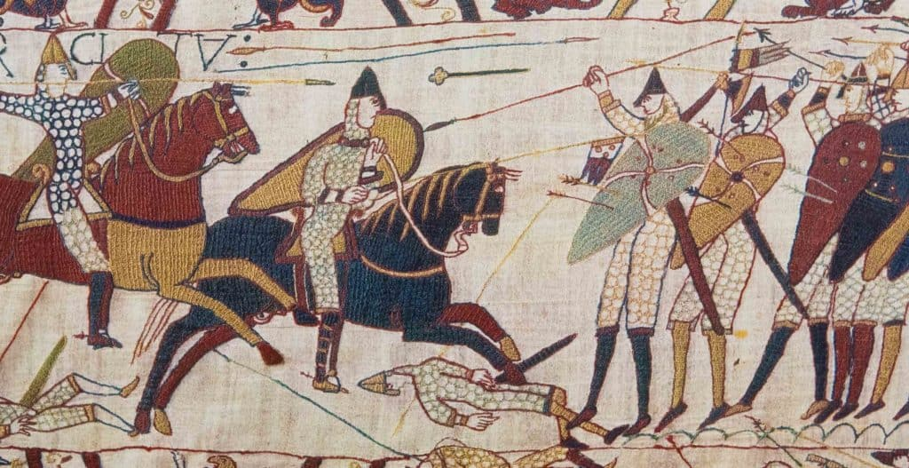
Year 7
History Homework Booklet
Term 1 – Autumn Term
2026
Topic 1: What is History?
Topic 2: How powerful was Anglo-Saxon England?
Topic 3: How did England change under the Normans?
Name:………………………………………………………………...
Class: ………………………………………………………………..
Teacher: …………………………………………………………..

Slide 2
Page 1
Homework 1
Task 1:
Learn questions 1-10 of Topic 1: What is history? The core knowledge questions can be found at the back of your homework booklet. You should use strategies like flashcards or ‘cover, write, reveal’ to help you.
Task 2: Following your revision, complete the core knowledge test below.
 | Question | Answer
1 | What are Primary sources?
2 | What is chronology?
3 | What is continuity?
4 | What is progress?
5 | What is BC?
6 | How many years are in a century?
7 | What is regress?
8 | How many years are there in a decade?
9 | What are secondary sources?
10 | What is AD?

Slide 3
Task 3: Complete the activities below. They all test your knowledge and understanding of the core historical concept of chronology.
Page 2
A) What period is covered within the century given below? The first one has been done for you.
15th century 1400 AD - 1499 AD
13th century
18th century
21st century
10th century
8th century
B) Circle the correct century that reflects the date
1348AD 1585AD
A) 14th century B) 13th century A) 16th century B) 14th century
1896AD 785AD
17th century B) 19th century A) 7th century B) 8th century
C) Write the periods of time chronologically onto the timeline below.
The Modern Era The Renaissance The Middle ages The Industrial period The Dark ages
D) For each statement below, decide if it is an example of progress, continuity or regress.
Anglo-Saxon kings used their taxes to improve roads and marketplaces across the kingdom.
Crops like wheat, barley and rye were grown for many centuries in England.
Kings had the power to make laws in isolation for most of the middle ages.
People were less healthy in the Industrial period than they had been in the Anglo-Saxon period
Danelaw helped to establish a peace between Vikings and Anglo-Saxons.

Slide 4
Page 3
Homework 2
Task 1:
Learn questions 1-12 of Topic 2: How powerful was Anglo-Saxon England? The core knowledge questions can be found at the back of your homework booklet. You should use strategies like flashcards or ‘cover, write, reveal’ to help you.
Task 2: Following your revision, complete the core knowledge test below.
 | Question | Answer
1 | What is the definition of trade?
2 | Who were the Anglo-Saxons?
3 | What is an Earl?
4 | What percentage of Anglo-Saxons lived in towns?
5 | Name two reasons Anglo-Saxon England was so wealthy (prosperous).
6 | What was the Witan?
7 | What was a ceorl?
8 | How did Earls help the King to maintain power?
9 | Who were the Vikings?
10 | Give one power of Anglo-Saxon kings.

Slide 5
Page 4
Task 4: A secondary source is anything that has been created by people living after the event or the period of study. These are usually created by historians who have researched extensively. Their views are also known as historical interpretations. Below is a view of a historian about the power of kings in Anglo-Saxon England. Read it carefully and then complete the tasks which follow.
Interpretation 1: Written by Lucy Marsh in her article Anglo-Saxon England, written in 2018.
The social hierarchy of Anglo – Saxon England meant that there were clear roles for everyone. The king was the ultimate source of authority. This meant that all his decisions were final, partly due to the belief that God had chosen the king so any challenge to the king would be seen as a challenge to God. We call this belief anointed by God. Even though there were people who controlled earldoms (earls), most earls relied on the king to grant them their power. Ultimately, the king could reduce the power of his earls or completely remove them.
1. Who is the author of this interpretation?
2. When was this interpretation written?
3. Which of the two options below best summarises the opinion of the historian? Circle your choice.
A) Anglo-Saxons kings had so much power because people believed they had been chosen by God to rule over them.
B) Anglo-Saxon kings were so powerful because they were trained to rule with authority.
4. Which statement from the interpretation would you use to best support the view given by the historian? Circle your choice from the options below.
A) “The social hierarchy of Anglo – Saxon England meant that there were clear roles for everyone” B) “The king was the ultimate source of authority”
C) “the belief that God had chosen the king so any challenge to the king would be seen as a challenge to God.”
5. The historian suggests the power of kings was greater than the power of earls in Anglo-Saxon England. Do you agree with their view? Circle from the options below.
A) I agree B) I disagree
6. From your knowledge about the power of kings in Anglo-Saxon England, provide an example to justify your choice to question 5. Write this in the space below.

Slide 6
Page 5
Homework 3
Task 1:
Learn Q1-15 of Topic 3: How did England change under the Normans? The core knowledge questions can be found at the back of your homework booklet. You should use strategies like flashcards or ‘cover, write, reveal’ to help you.
Task 2: Following your revision, complete the core knowledge test below.
1 | Who were the contenders to the throne in 1066?
2 | What tactic did the Normans use against the Anglo-Saxons that led to victory?
3 | What was the Harrying of the North?
4 | In what year was the Domesday Book created?
5 | Which king died in January 1066 without a son?
6 | What was the name of the system William introduced to structure society?
7 | Name 2 consequences of the Harrying of the North.
8 | What three factors help to explain why William won the Battle of Hastings?
9 | What is the name of the castles William built in England?
10 | What is a knight?

Slide 7
Page 6
Task 2:
The information below gives detail on the King and his government in the Middle Ages. This will help to extend your learning for this topic. Read through the information and then answer the questions which follow from it on PG 7.
The king was the head of the government and made all the important decisions. His most important tasks were to defend his country and his people from attack, usually by commanding the army himself. Military skills were therefore important, although not essential as he could rely on the military skills of his earls. It was also essential the king passed good laws and made sure the laws were obeyed. He needed to defend the Church and appoint its leaders, as well as manage his earls so they co-operated with his decisions and helped him run the country effectively. The king was the only person with the power to settle disputes between the nobles. The best kings used a combination of two things to manage their nobles – they rewarded nobles with land and wealth and dominated them with their strong personalities. Today there is a large civil service to do all the administration governments need. In the eleventh century, kings had only a small number of administrators. The administrators wrote down the king’s laws and sent out written orders called writs to officials around the country. The groups of people helping the king were known as the royal household and the royal court. The household and court were not physical buildings but groups of people who moved around the country with the king. When kings needed advice on important issues, they called a meeting known as the Witanagemot, or Witan – an Anglo-Saxon word meaning ‘meeting of wise men’. The Witan did not have regular meetings or a regular membership. It met whenever the king decided to hold a meeting and only those he summoned could attend. The men summoned included earls, thegns and senior members of the Church, including archbishops and bishops. Even then the king made the final decisions. However, by consulting the most powerful men in the country, he had shown that he respected their views and they were more likely to support his decisions. The Witan’s most powerful role came if there was doubt about who would be the next king. Then the Witan could meet and make a recommendation or decision, but in most cases the real decision was made by whoever had the strongest military power.
Key Words:
Appoint: choose to fill a particular role/job.
Disputes: Disagreements or arguments.
Administration: The group of people that does all the paperwork and organising to ensure a country runs smoothly.
Thegns: Local lords
Consulting: asking for the opinions of others.

Slide 8
Task 3: Using the information on The king and his government, complete the comprehension questions below.
Page 7
List two of the King’s main roles.
………………………………………………………………………………………………………………………………………………………………………………………………………………………………………………………………………………………………………………………………………..
What two ways could King’s use to manage their nobles?
………………………………………………………………………………………………………………………………………………………………………………………………………………………………………………………………………………………………………………………………………..
3. What was the role of administrators in the 11th Century?
………………………………………………………………………………………………………………………………………………………………………………………………………………………………………………………………………………………………………………………………………..
4. Describe what the royal household and royal court were.
………………………………………………………………………………………………………………………………………………………………………………………………………………………………………………………………………………………………………………………………………..
5. What is the meaning of the word ‘Witan’?
…………………………………………………………………………………………………………………………………………………………………
When would the Witan meet?
………………………………………………………………………………………………………………………………………………………………...
7. Who was a part of the Witan?
………………………………………………………………………………………………………………………………………………………………………………………………………………………………………………………………………………………………………………………………………..
8. What was the most important role that the Witan had?
………………………………………………………………………………………………………………………………………………………………………………………………………………………………………………………………………………………………………………………………………..
9. Challenge: How might earls challenge the power of the king?
……………………………………………………………………………………………………………………………………………………………….....

Slide 10
Homework 4
Task 1:
Revise Q1-15 of Topic 2: How did England change under the Normans? The core knowledge questions can be found at the back of your homework booklet. You should use strategies like flashcards or ‘cover, write, reveal’ to help you.
Task 2: Following your revision, complete the quiz below by circling your answers. There may be more than one correct answer per question.
Page 8
Q1) King Edward caused a succession crisis in 1066. True or False?
Q2) Who did the Witan crown king following the death of Edward the Confessor?
Q3) Who fought at the Battle of Stamford Bridge?
A) The Anglo-Saxons
B) The Vikings
C) The Normans
Q4) William fought as a knight during the Battle of Hastings. True or false?
Q5) What reasons below explain why William won the Battle of Hastings?
A) He was well prepared
B) He used better tactics
C) He had a stronger army
D) He used a shield wall
Q6) What was the Feudal system?
Q7) The Harrying of the North punished rebels in the south of England. True or false?
Q8) From the examples below, which ones were consequences of the Harrying of the North?
A) Crops destroyed B) Large-scale deaths C) Cannibalism D) Loss of homes
Q9) What was the Domesday Book?
Q10) Name the 3 contenders to the throne in 1066?
1.
2.
3.

Slide 11
Page 9
Task 3: A primary source is anything that has been created by people living during the event or the period of study. Below is a primary source which gives information about the Battle of Hastings. Read it carefully and then complete the tasks which follow.
Source A: Written by William of Malmesbury in his book Deeds of the kings of the English. This extract was written in about 1140.
The English... passed the night without sleep, in drinking and singing, and, in the morning, proceeded without delay towards the enemy; all were on foot, only some armed with battle-axes... The king Harold himself was on foot and stood with his brothers in order that, while all shared equal danger, none might think of retreating... On the other side, the Normans passed the whole night in confessing their sins...The following morning, the English few in number and brave in the extreme... fought with ardour, for a great part of the day... But Harold fell, his brain pierced by an arrow...
Q1. Who is the author of this source?
Q2. When was this source written?
Q3. Using the information in the source, what reasons does the author give to help explain why the English were defeated? List these in the space below.
Q4. Does the author give a positive view or a negative view of the English at the Battle of Hastings? Circle your choice below.
A) Positive view B) Negative view
Q5. What evidence from the source helps to justify your decision to question 4? Copy out a sentence or a phrase from the source directly and write it in the space provided.
Q6. From your own knowledge, give two reasons that are not provided in the source to explain why the English were defeated in the Battle of Hastings.
1.
2.

Slide 12
Homework 5
Task 1:
Revise all the core knowledge questions from Topic 1, 2 and 3. You should use strategies like flashcards or ‘cover, write, reveal’.
Task 2: Complete the core knowledge test below. These questions are a combination from both topics.
Page 10
1 | Who were the contenders to the throne in 1066?
2 | Who fought at the Battle of Stamford Bridge?
3 | What percentage of Anglo-Saxons lived in towns?
4 | What is a knight?
5 | What was the name of the system William introduced to structure society?
6 | What was the Harrying of the North?
7 | What is continuity?
8 | What was a ceorl?
9 | How did Earls help the King to maintain power?
10 | In what year was the Domesday Book created?
11 | What three factors help to explain why William won the Battle of Hastings?
12 | What was the Witan?

Slide 13
Page 11
Task 3:
Read the article. This will help to extend on your learning from in lessons. The article below is about the Harrying of the North. You need to complete the activities at the side of the page.
Victory at the Battle of Hastings did not guarantee William control of England. The rebellious North had to be brought into line, which it was, ruthlessly, in the winter of 1069. By James Aitcheson
The Battle of Hastings is the most famous event of the Norman Conquest, but it was only the beginning of the invaders' consolidation of power in England. For several years afterwards, the country was faced internal conflict as the Normans fought to extend their rule, leading to a notorious campaign known today as the ‘Harrying of the North’.
The Harrying, which took place over the winter of 1069–70, saw William’s knights lay waste to Yorkshire and neighbouring shires. Entire villages were destroyed and their people killed, livestock slaughtered and stores of food destroyed. Throughout 1067 and 1068 there had been lots of localised revolts by foreign enemies in various corners of the country – Devon, Kent, Herefordshire and the midland earldom of Mercia – although each of these was swiftly put down. Castles were built, including in the major towns of Warwick, Nottingham, York, Lincoln, Huntingdon and Cambridge, in an effort to put down the disturbances and impose control. Nevertheless, it is important to recognise that, even by the beginning of 1069, William was still not master of the entire kingdom. His authority extended no further north than York and it was in the region beyond that was the greatest threat to his rule.
William’s early attempts to bring the northerners under his control had involved appointing English earls to govern them: first Copsig and then Gospatric. Both appointments had been dismal failures: the former was assassinated by a rival in 1067; the latter joined the rebels in 1068. Finally, in January 1069, William sent one of his own Norman men, Robert Cumin, to conquer the region by force, only for him to be ambushed and slaughtered at Durham. William was furious and was determined to put the North in its place once and for all. William set out and eventually reached York a little before Christmas. Shortly after Christmas in 1069 he divided his army into raiding-parties, which he sent to carry out the Harrying.
List the actions of William and his knights during the harrying of the North.
List two reasons why William carried out the Harrying.

Slide 14
The object of the campaign was two-fold. First, William sought to find and get rid of the Northumbrian rebels. More importantly, by destroying the region’s resources so completely, he sought to put an end to the cycle of rebellions by ensuring that any future rebels would lack the means to support themselves.
William’s armies spread out over more than one hundred miles of territory, as far north as the River Tyne. The 12th-century chronicler John of Worcester writes that food was so scarce in the aftermath that people were reduced to eating not just horses, dogs and cats but also human flesh.
Another historian, Orderic Vitalis – a contemporary of John’s – claims that as many as 100,000 people died as a result of famine in the following months. While we are rightly suspicious of such a round figure, a death toll somewhere in the tens of thousands is not hard to believe this at a time when the total population of England was probably little more than two million.
The affected region took a long time to recover. No village remained lived in between York and Durham and that the countryside remained empty and uncultivated for nine years. Even by 1086, when Domesday was compiled, one third of the available land in Yorkshire was still recorded as vasta ('waste').
In the course of just a few weeks William had not only clearly demonstrated the punishment that awaited those who rose against him, but he had also snuffed out what lingering hopes the rebels might have had of driving out the invaders. There were further risings in the years to come, but William never again faced a crisis of the same magnitude as he had in 1069. What Hastings had heralded, the Harrying confirmed. The Normans were here to stay.
Page 12
What were William’s two aims?
What was one consequence of the Harrying?
Give one impact on the people of the north.
List the long-term effects of the event.
List one reason why the Harrying helped William to control England.

Slide 15
Page 13
Core knowledge questions

Slide 16
Page 14
Topic 1What is History?
 | Question | Answer
1 | What are Primary sources? | Something that was made at the time of an event by someone who was there
2 | What are secondary sources? | Something that was created by people who are living after the event
3 | What is chronology? | The order of time from oldest to newest.
4 | What is progress? | When changes have occurred to make things better.
5 | What is continuity? | Where there has been little change, so things are the same.
6 | What is regress? | When changes have occurred to make things worse.
7 | How many years are there in a century? | 100
8 | How many years are there in a decade? | 10
9 | What is BC? | Years before the birth of Jesus Christ
10 | What is AD? | Anno Domini – years after the birth of Jesus Christ

Slide 17
Page 15
Topic 2
How powerful was Anglo-Saxon England?
 | Question | Answer
1 | What is the definition of trade? | To buy, sell and exchange products.
2 | Who were the Vikings? | People from Scandinavia around the period 750-1100.
3 | What is an Earl? | A powerful noble in Anglo-Saxon England.
4 | Who were the Anglo-Saxons? | Tribes from Germany, the Netherlands and Denmark who settled from 410AD
5 | Why was Anglo-Saxon England so powerful? | Good trade Strong tax system Effective government Defences and army
6 | What is an heir? | Someone that is due to inherit land or a title.
7 | What percentage of Anglo-Saxons lived in towns? | 10%
8 | What reasons show why Anglo-Saxon England was so wealthy (prosperous)? | There were natural resources e.g. tin, copper and iron There was fertile land for crops Trade generated money
9 | What was the Witan? | A group of important men who advised the king.
10 | What was a ceorl? | They were peasants who were not tied to a lord (free)
11 | How did Earls help the King to maintain power? | They collected taxes They oversaw the courts They raised local (regional ) armies
12 | What were the powers of Anglo-Saxon kings? | To make laws To raise national armies To mint coins To control taxation To give titles and land

Slide 18
Topic 3
How did England change under the Normans?
Page 16
1 | Who died in January 1066 without a son? | King Edward the Confessor
2 | Who were the contenders to the throne in 1066? | Harold Godwinson Harald Hardrada William Duke of Normandy
3 | Who did the Witan crown king in January 1066? | Harold Godwinson
4 | How fought at the Battle of Stamford Bridge in September 1066? | Harald Hardrada and Harold Godwinson
5 | When was the Battle of Hastings? | 14th October 1066
6 | What tactic did the Normans use the led to victory? | The feigned retreat
8 | What is a knight? | A warrior who is trained to fight on horseback
9 | What three factors help to explain why William won the Battle of Hastings? | He was well prepared He had a better army His tactics were
10 | What was the Harrying of the North? | When William destroyed the North of England to punish rebels
11 | What were the consequences of the Harrying of the North? | Crops destroyed Homes burned They resorted to cannibalism 100,000 people died.
12 | What was the name of the system William introduced to structure society? | The Feudal System
13 | What castles did William build across England? | Motte and bailey castles
14 | In what year was the Domesday Book created? | 1086
15 | What was the Domesday Book? | A survey of England showing who held land

